Slide 1
Chest Pneumonia Detection
Data Analysis and Machine Learning Using Python Internship
One Man Army
Harshit Gupta

Slide 2
Outline
Problem Statement
Objective
Motivation
Dataset Description

Slide 3
Problem Statement
The risk of pneumonia is immense for many, especially in developing nations where billions face energy poverty and rely on polluting forms of energy.
The WHO estimates that over 4 million premature deaths occur annually from household air pollution-related diseases including pneumonia [1].
Over 150 million people get infected with pneumonia on an annual basis especially children under 5 years old [2].
Accurate and fast diagnosis can guarantee timely access to treatment and save much needed time and money for those already experiencing poverty.
[1] World Health Organization, Household Air Pollution and Health [Fact Sheet], WHO, Geneva, Switzerland, 2018,
http://www.who.int/newa-room/fact-sheets/detail/household-air-pollution-and-health.
[2] I. Rudan, L. Tomaskovic, C. Boschi-Pinto, and H. Campbell, “Global estimate of the incidence of
clinical pneumonia among children under five years of age,” Bulletin of the World Health Organization, vol. 82, pp. 85–903, 2004.

Slide 4
Objective
To develop a model which can detect the images and determine if a person is suffering from pneumonia.
To achieve high accuracy in the results
To make the model time and money efficient

Slide 5
Motivation
The world is fighting a hard battle against the Covid-19 pandemic. Studies show that the health conditions of patients are very much similar to Pneumonia.
One of the prime reasons as to why Corona Virus hit the world so hard is because the tests are time taking and it is difficult to detect.
This motivated me to work on this project to contribute towards speeding up the testing and to make it more efficient.

Slide 6
Dataset Description
5856 X-Ray Images
Train
Test
Validation
Pneumonia
Normal
Normal
Pneumonia
Normal
Pneumonia
234
390
1341
3875
8
8
J. Melendez, G. B. Van, P. Maduskar et al., “A novel multiple-instance learning-based approach to computer-aided detection of tuberculosis on chest x-ray,” IEEE Transactions on Medical Imaging, vol. 34, no. 1, pp. 179–192, 2015.

Slide 7
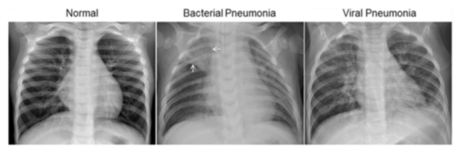

Slide 8
Thank You
Harshit Gupta

